Slide 1
Algorithm Evaluation and Error Analysis class 7
Multiple View Geometry
Comp 290-089
Marc Pollefeys

Slide 2
Content
Background: Projective geometry (2D, 3D), Parameter estimation, Algorithm evaluation.
Single View: Camera model, Calibration, Single View Geometry.
Two Views: Epipolar Geometry, 3D reconstruction, Computing F, Computing structure, Plane and homographies.
Three Views: Trifocal Tensor, Computing T.
More Views: N-Linearities, Multiple view reconstruction, Bundle adjustment, auto-calibration, Dynamic SfM, Cheirality, Duality

Slide 3
Multiple View Geometry course schedule
(subject to change)
Jan. 7, 9 | Intro & motivation | Projective 2D Geometry
Jan. 14, 16 | (no class) | Projective 2D Geometry
Jan. 21, 23 | Projective 3D Geometry | (no class)
Jan. 28, 30 | Parameter Estimation | Parameter Estimation
Feb. 4, 6 | Algorithm Evaluation | Camera Models
Feb. 11, 13 | Camera Calibration | Single View Geometry
Feb. 18, 20 | Epipolar Geometry | 3D reconstruction
Feb. 25, 27 | Fund. Matrix Comp. | Structure Comp.
Mar. 4, 6 | Planes & Homographies | Trifocal Tensor
Mar. 18, 20 | Three View Reconstruction | Multiple View Geometry
Mar. 25, 27 | MultipleView Reconstruction | Bundle adjustment
Apr. 1, 3 | Auto-Calibration | Papers
Apr. 8, 10 | Dynamic SfM | Papers
Apr. 15, 17 | Cheirality | Papers
Apr. 22, 24 | Duality | Project Demos

Slide 4
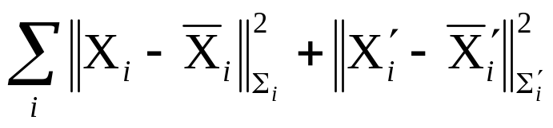
Maximum Likelihood Estimation
DLT not invariant ⇒ normalization
Geometric minimization invariant
Iterative minimization
  Cost function
  Parameterization
  Initialization
  Minimization algorithm

Slide 5
Automatic computation of H
Objective
Compute homography between two images
Algorithm
Interest points: Compute interest points in each image
Putative correspondences: Compute a set of interest point matches based on some similarity measure
RANSAC robust estimation: Repeat for N samples
(a) Select 4 correspondences and compute H
(b) Calculate the distance d⊥ for each putative match
(c) Compute the number of inliers consistent with H (d⊥<t)
Choose H with most inliers
Optimal estimation: re-estimate H from all inliers by minimizing ML cost function with Levenberg-Marquardt
Guided matching: Determine more matches using prediction by computed H
Optionally iterate last two steps until convergence

Slide 6
Algorithm Evaluation and Error Analysis
Bounds on performance
Covariance estimation
?
uncertainty
?
residual error

Slide 7

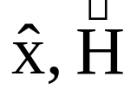
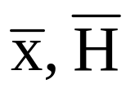
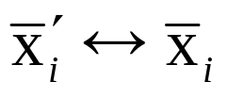
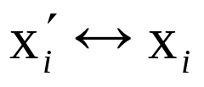

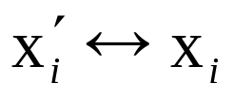
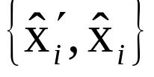
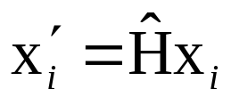
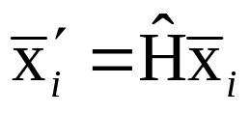
Algorithm evaluation
Test on real data or
test on synthetic data
measured coordinates
estimated quantities
true coordinates
Generate synthetic correspondences
Add Gaussian noise, yielding
Estimate from using algorithm
maybe also
Verify how well or
Repeat many times (different noise, same σ)

Slide 8
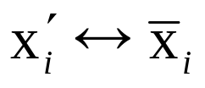
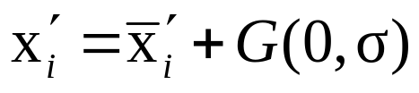
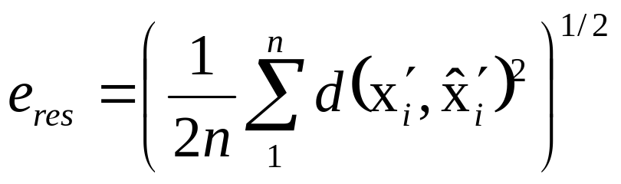

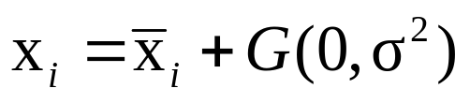
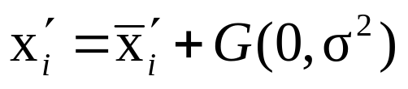
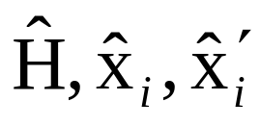
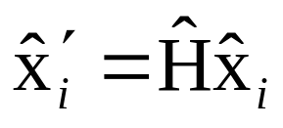
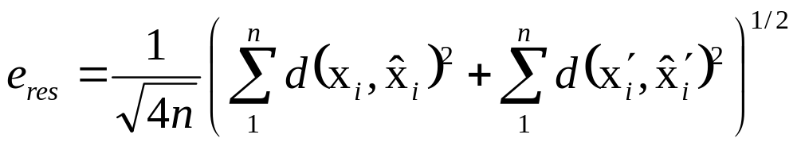
Error in one image
Estimate , then
Note: residual error ≠ absolute measure of quality of
e.g. estimation from 4 points yields e_{res}=0
more points better results, but e_{res} will increase
Error in two images
Estimate so that , then

Slide 9


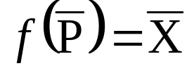
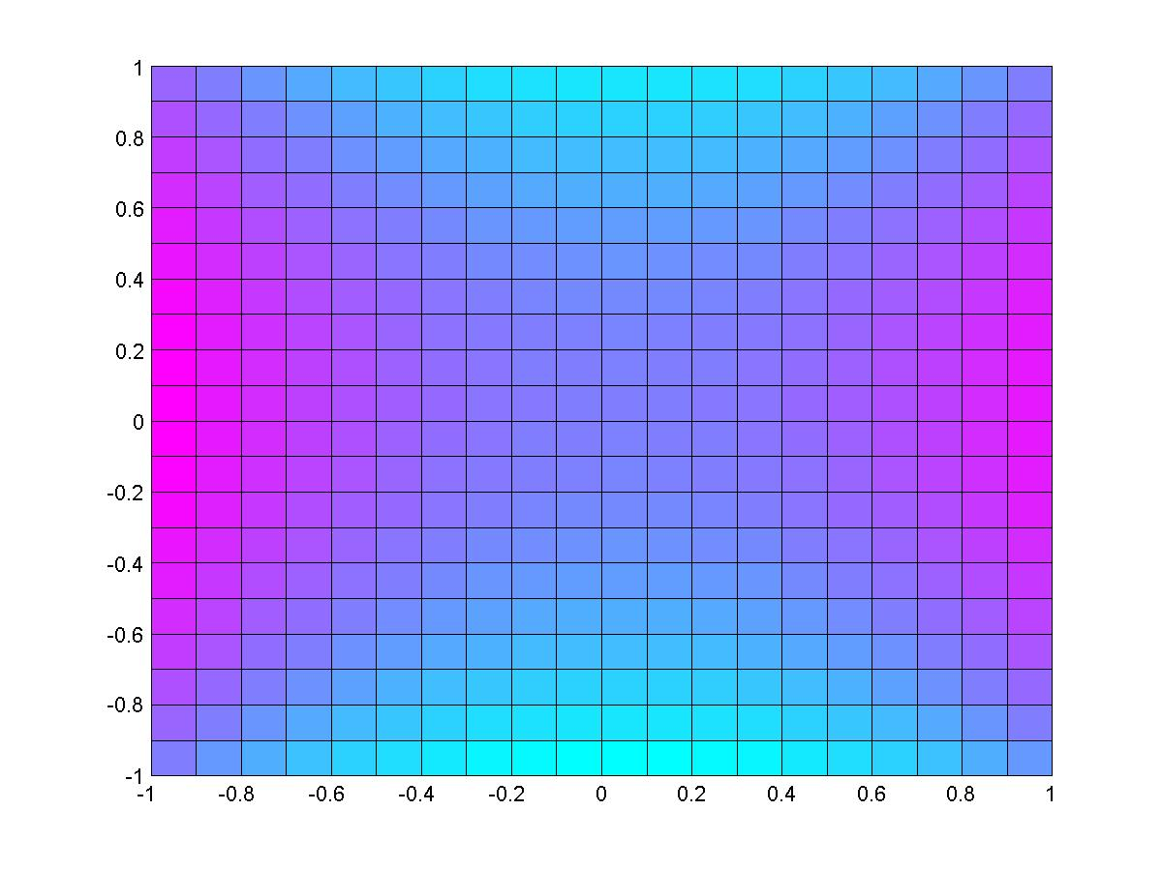
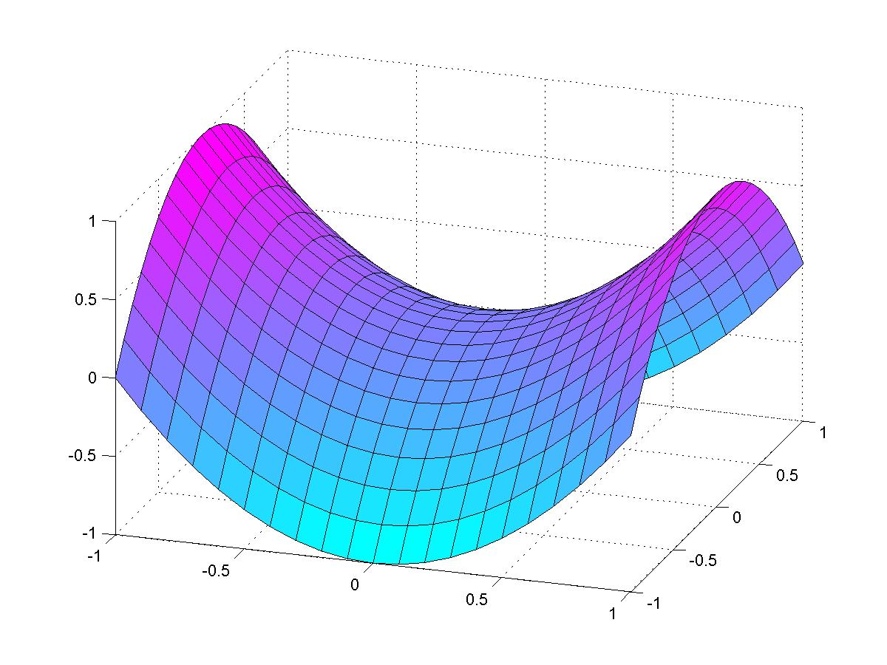
Optimal estimators (MLE)
Estimate expected residual error of MLE,
Other algorithms can then be judged to this standard
f : ^{M} → ^{N} (parameter space to measurement space)
^{N}
^{M}
f
P
X
S_{M}
^{M}
^{N}
dimension of submanifold S_{M} = #essential parameters

Slide 10
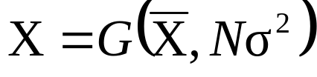
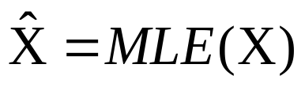

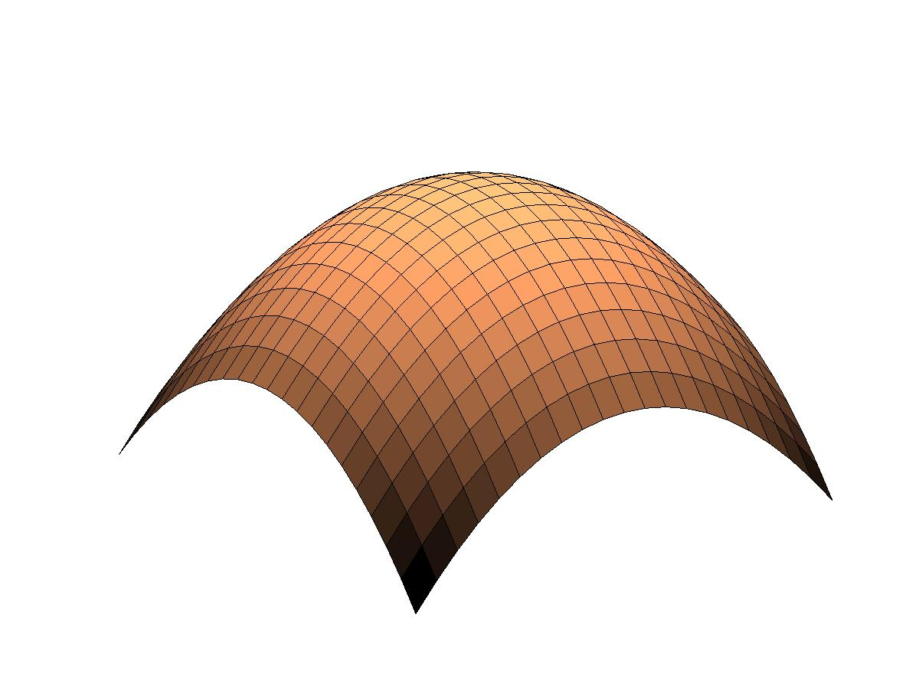
Assume S_{M} locally planar around
projection of isotropic Gaussian distribution on ^{N} with total variance Nσ² onto a subspace of dimension s is an isotropic Gaussian distribution with total variance sσ²
X
n
X
X
S_{M}

Slide 11
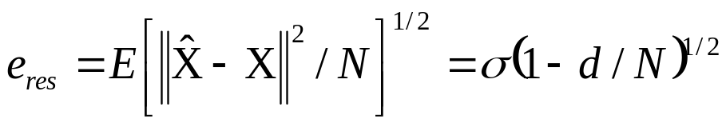
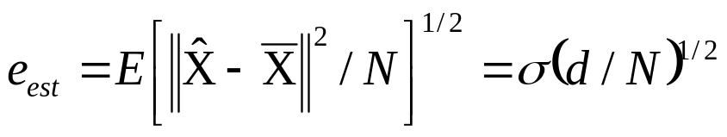
N measurements (independent Gaussian noise σ²)
model with d essential parameters
(use s=d and s=(N-d))
RMS residual error for ML estimator
RMS estimation error for ML estimator
X
n
X
X
S_{M}
Notes:
Note that these are lower bound for residual error against which a particular algorithm may be measured

Slide 12


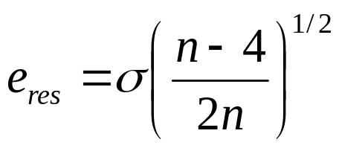
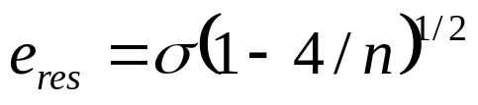


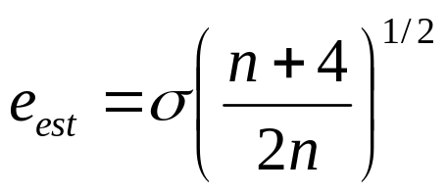
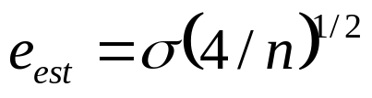
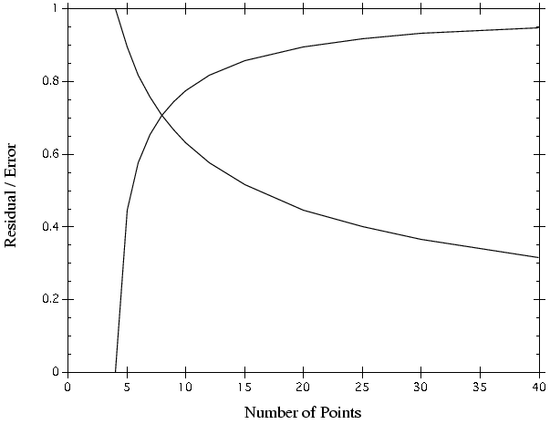
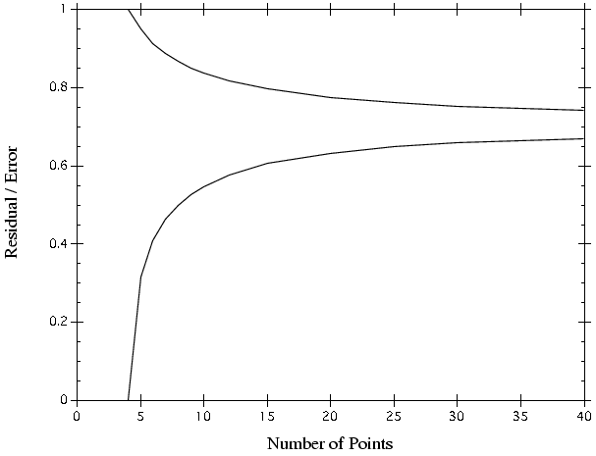
Error in one image
Error in two images

Slide 13
Covariance of estimated model
Previous question: how close is the error to smallest possible error?
Independent of point configuration
Real question: how close is estimated model to real model?
Dependent on point configuration
(e.g. 4 points close to a line)

Slide 14
Forward propagation of covariance
Let v be a random vector in ^{M} with mean v and covariance matrix Σ, and suppose that f: ^{M} →^{N} is an affine mapping defined by f(v)=f(v)+A(v-v). Then f(v) is a random variable with mean f(v) and covariance matrix AΣA^{T}.
Note: does not assume A is a square matrix

Slide 15
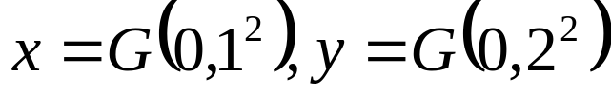


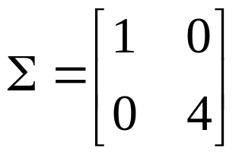

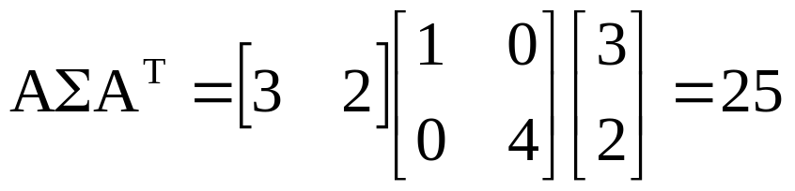

Example:

Slide 16
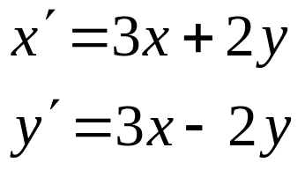
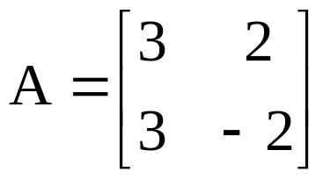
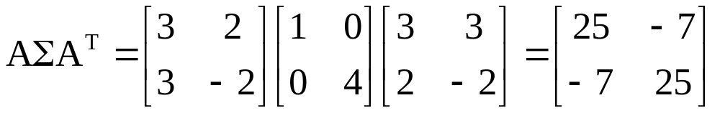
Example:

Slide 17
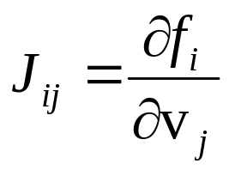

Non-linear propagation of covariance
Let v be a random vector in ^{M} with mean v and covariance matrix Σ, and suppose that f: ^{M} →^{N} differentiable in the neighborhood of v. Then, up to a first order approximation, f(v) is a random variable with mean f(v) and covariance matrix JΣJ^{T}, where J is the Jacobian matrix evaluated at v
Note: good approximation if f close to linear
within variability of v

Slide 18
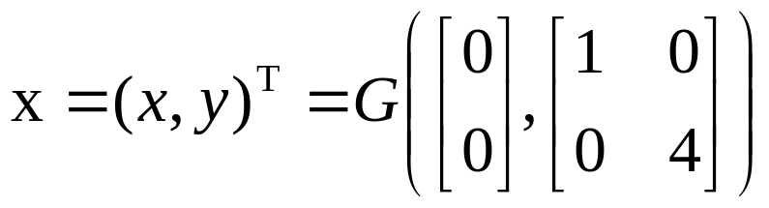
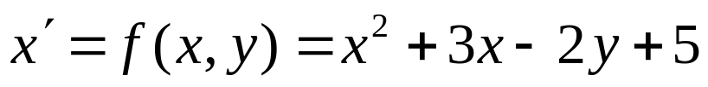
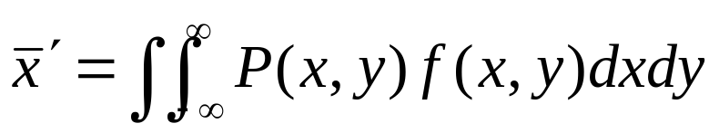
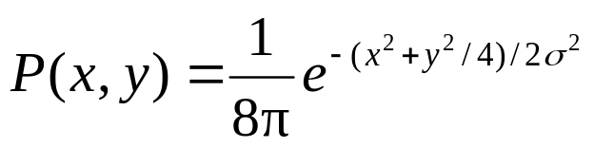
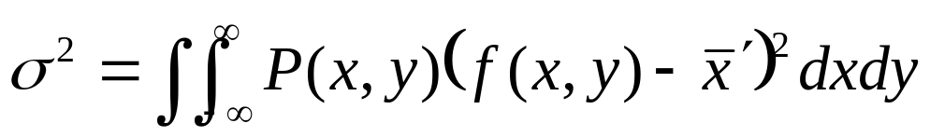

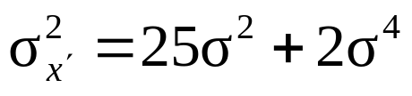


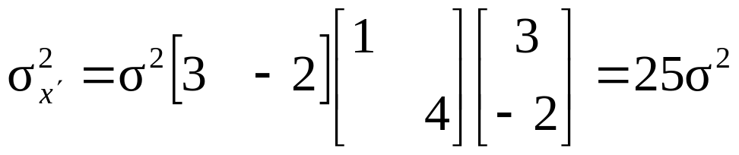
Example:

Slide 19
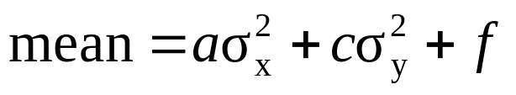

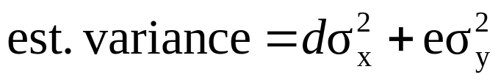
Example:

Slide 20


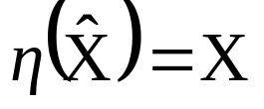
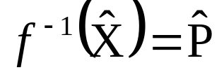
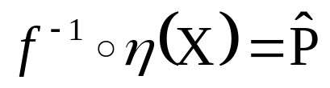
Backward propagation of covariance
f : ^{M} → ^{N}
^{N}
^{M}
f ⁻¹
X
P
η
X

Slide 21








Backward propagation of covariance
X
P
f ⁻¹
η
X
assume f is affine
what about f ⁻¹oη ?
minimize:
solution:

Slide 22




Backward propagation of covariance
X
P
f ⁻¹
η
X

Slide 23

Backward propagation of covariance
X
P
f ⁻¹
η
X
If f is affine, then
non-linear case, obtain first order approximations by using Jacobian

Slide 24



Over-parameterization
In this case f is not one-to-one and rank J<M
so can not hold
e.g. scale ambiguity ⇒ infinite variance!
However, if constraints are imposed, then ok.
Invert d xd in stead of MxM

Slide 25

Over-parameterization
When constraint surface is locally orthogonal to the null space of J
(pseudo-inverse)
e.g. usual constraint ||P||=1
||P||=1
nullspace

Slide 26






Example: error in one image
Estimate the transformation from the data
Compute Jacobian , evaluated at
The covariance matrix of the estimated is given by

Slide 27


Example: error in both images
separate in homography and point parameters

Slide 28


Using covariance matrix in point transfer
Error in one image
Error in two images
(if h and x independent, i.e. new points)

Slide 29

Example:
σ=1 pixel Σ=0.5cm
(Crimisi’97)

Slide 30

Example:
σ=1 pixel Σ=0.5cm
(Crimisi’97)

Slide 31

Example:
(Crimisi’97)

Slide 32


Monte Carlo estimation of covariance
To be used when previous assumptions do not hold (e.g. non-flat within variance) or to complicate to compute.
Simple and general, but expensive
Generate samples according to assumed noise distribution, carry out computations, observe distribution of result

Slide 33



Next class: Camera models

